Slide 1
Parallel Programming with OPENMP
Akhila Prabhakaran
Consultant Scientist/Technologist
Supercomputer Education and Research Centre
Indian Institute of Science
akhilap@iisc.ac.in

Slide 2
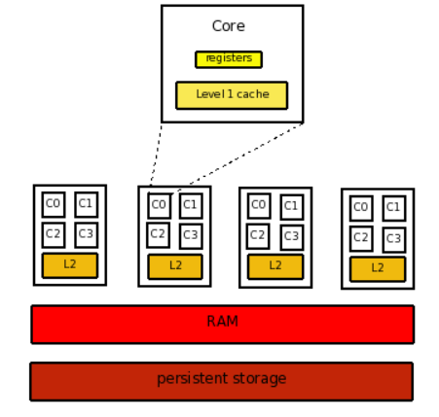
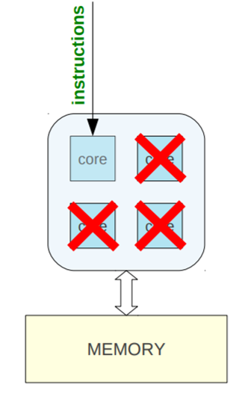
OPENMP: Motivation
Sequential program uses a single core/ processor while all other processors are idle.
Using OMP pragmas can enable utilizing all processors in parallel for a program.
Notes:
An effective parallel implementation is one which closely matches its target hardware and provides the user ease in programming.

Slide 3
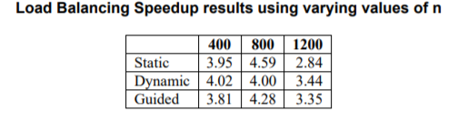
OPENMP: Motivation
https://www.openmp.org/about/whos-using-openmp/
Parallel Gaussian Elimination Using OpenMP on 4 processors
Matlab – TSA & NaN toolbox
OpenMP is used in two core functions (sumskipnan_mex&covm_mex), which compute the sum, the covariance matrix, and counts the samples which are not NaN. Speed up of 11 has been observed on multicore machines with 12 cores
Notes:
An effective parallel implementation is one which closely matches its target hardware and provides the user ease in programming.

Slide 4
OPENMP Motivation
#include <stdio.h>
#include <stdlib.h>
int main()
{
//Do this part in parallel
printf(“Hello World”);
return 0;
}
#include <stdio.h>
#include <stdlib.h>
#include <omp.h>
int main()
{
omp_set_num_threads(16);
//Do this part in parallel
#pragma omp parallel
{
//structured block of code
printf(“Hello World”);
}
return 0;
}

Slide 5
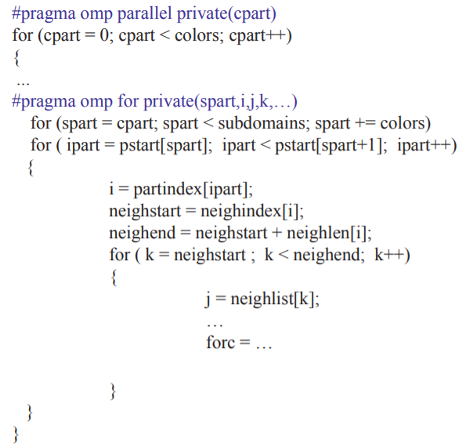
Force computations – piece of parallel code

Slide 6
OPENMP : Overview
Collection of compiler directives and library functions for creating parallel programs for shared-memory computers.
The “MP” in OpenMP stands for “multi-processing”(shared-memory parallel computing)
Combined with C, C++, or Fortran to create a multithreading programming language, in which all processes are assumed to share a single address space.
Based on the fork / join programming model: all programs start as a single (master) thread, fork additional threads where parallelism is desired (the parallel region), then join back together.
Version 1.0 with fortran in 1997, supporting C & C++ there after, currently at version 5.0 in 2018.
Notes:
An effective parallel implementation is one which closely matches its target hardware and provides the user ease in programming.

Slide 7
OpenMP: Goals
Standardization: Provide a standard among a variety of shared memory architectures/platforms
Lean and Mean: Establish a simple and limited set of directives for programming shared memory machines. Significant parallelism can be implemented by using just 3 or 4 directives.
Ease of Use: Provide capability to incrementally parallelize a serial program. Provide the capability to implement both coarse-grained and fine-grained parallelism
Portability: Supports Fortran (77, 90, 95…), C, and C++. Public forum for API and membership
Notes:
Fine-grained parallelism means individual tasks are relatively small in terms of code size and execution time. The data is transferred among processors frequently in amounts of one or a few memory words. Coarse-grained is the opposite: data is communicated infrequently, after larger amounts of computation.

Slide 8
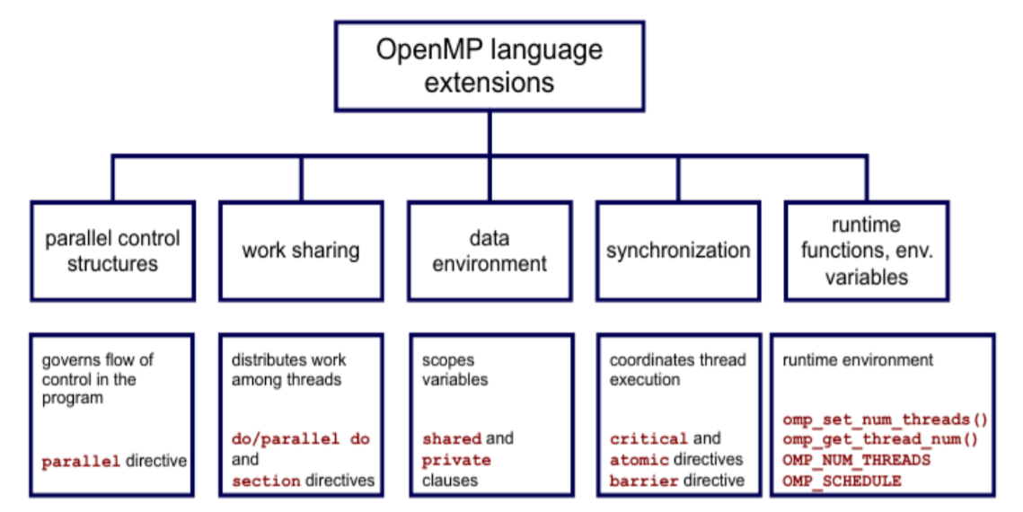
OpenMP: Core Elements
Notes:
Thread 0 is on CPU0 and at the fork 3 new threads are created and distributed to the remaining 3 CPUs

Slide 9
OPENMP #pragma
Special preprocessor instructions.
Typically added to a system to allow behaviors that aren’t part of the basic C specification.
Compilers that don’t support the pragmas ignore them.

Slide 10
#pragma omp parallel
How many threads? (OMP_NUM_THREADS)
Shared variables
#pragma omp parallel
{
Variables (private)
}
Shared
Variables
P0 – Thread 0
Private Stack
Parallel Region
P1 – Thread 1
Private Stack
P2 – Thread 2
Code within the parallel region is executed in parallel on all processors/threads.
Private Stack
P3 – Thread 3
Private Stack
Notes:
An environment variable is a variable whose value is set outside the program, typically through functionality built into the operating system or microservice. An environment variable is made up of a name/value pair, and any number may be created and available for reference at a point in time.

Slide 11
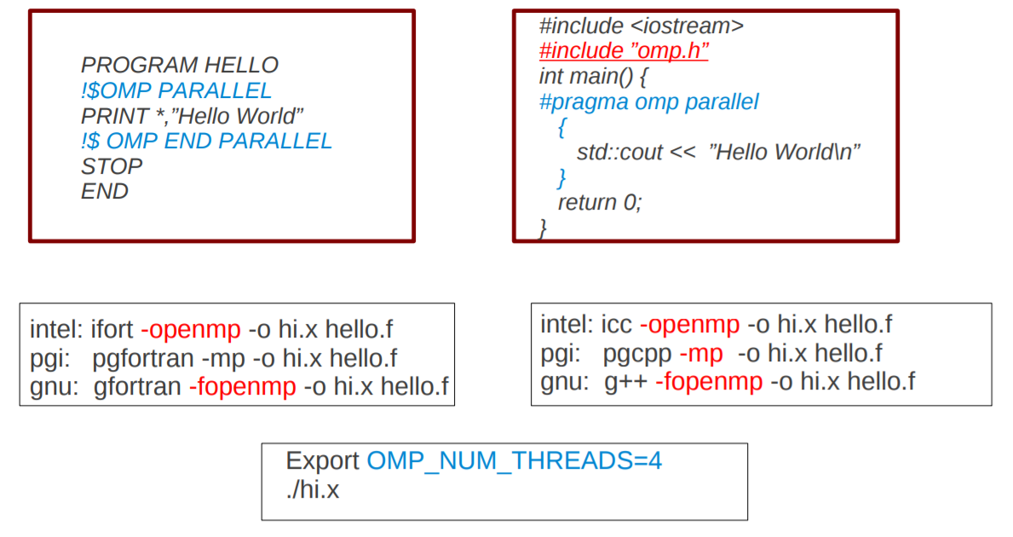
OpenMP - #pragma
Notes:
Yu create threads in OpenMP* with the parallel construct.

Slide 12
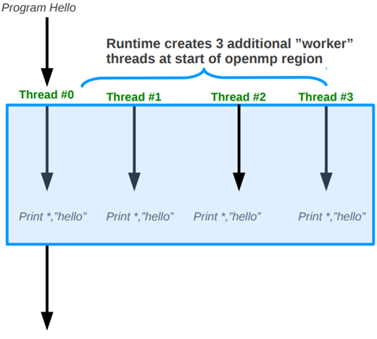
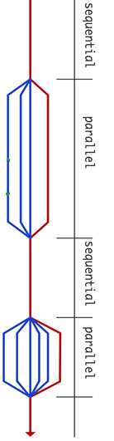
Hello World - OpenMP
Fork: master thread creates a team of parallel threads.
Threads are numbered from 0 (master thread) to N-1
Structured block of code
Implicit barrier at the end of a parallel section.
master thread executes sequentially until the first parallel region is encountered.
Parallelism added incrementally until performance goals are met.
Join: Team of threads complete the statements in the parallel region, synchronize and terminate
Notes:
Yu create threads in OpenMP* with the parallel construct.

Slide 13
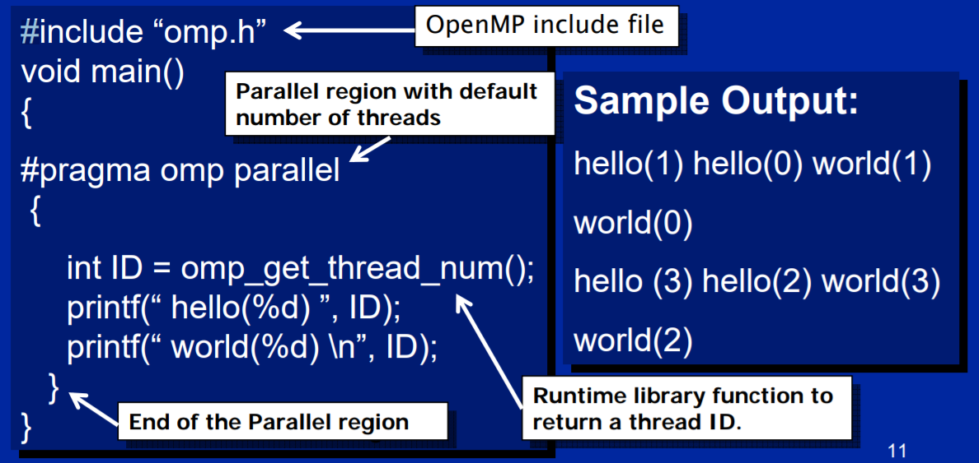
OPENMP: Basic functions
Notes:
Yu create threads in OpenMP* with the parallel construct.

Slide 14
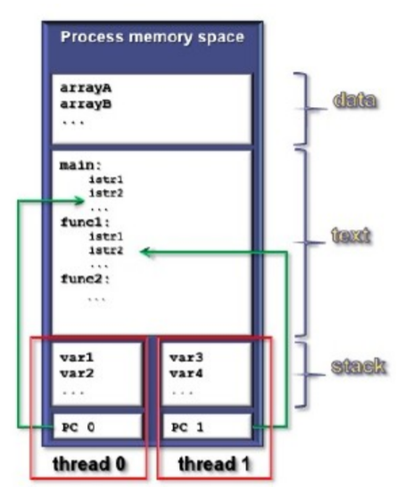
OPENMP: basic functions
Each thread has its own stack, so it will have its own private (local) variables.
Each thread gets its own rank - omp_get_thread_num
The number of threads in the team - omp_get_num_threads
In OpenMP, stdout is shared among the threads, so each thread can execute the printf statement.
There is no scheduling of access to stdout, output is non-deterministic.

Slide 15
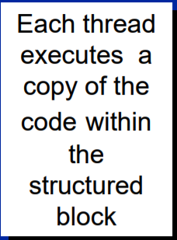
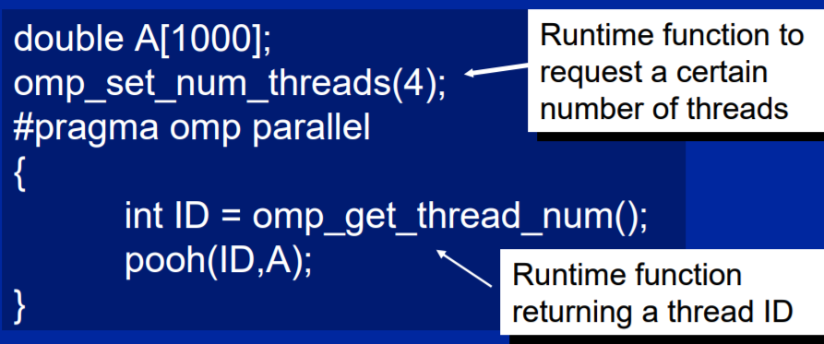
OPENMP: Run Time Functions
Create a 4 thread Parallel region :
Statements in the program that are enclosed by the parallel region construct are executed in parallel among the various team threads.
Each thread calls pooh(ID,A) for ID = 0 to 3

Slide 16
OpenMP Run Time Functions
Modify/check/get info about the number of threads
omp_get_num_threads() //number of threads in use
omp_get_thread_num() //tells which thread you are
omp_get_max_threads() //max threads that can be used
Are we in a parallel region? omp_in_parallel()
How many processors in the system? omp_get_num_procs()
Set explicit locks and several more...
OpenMP Environment Variables
OMP_NUM_THREADS: Sets the maximum number of threads in the parallel region, unless overridden by omp_set_num_threads or num_threads.
USE SET command in Windows or printenv command in linux to see current environment variables
Notes:
These variables control the execution of parallel code
A lock is a form of mutual exclusion
An object that can be held by at most one thread at a time. InitLock, SetLock, UnsetLock, Destroy Lock

Slide 17
OpenMP: Syntax
C/C++ (pragma) | directive-name | [clause,…]
#pragma omp | parallel | private(var1, var2) shared (var3) | #include <omp.h>
Required for all OpenMP C/C++ directives. | A valid OpenMP directive. Must appear after the pragma and before any clauses. | Optional. Clauses can be in any order and repeated as necessary unless otherwise restricted.
Fortran (sentinel) | directive-name | [clause…]
!$OMP C$OMP *$OMP | PARALLEL | PRIVATE(VAR1,VAR2) SHARED(VAR3) | !$OMP END PARALLEL

Slide 18
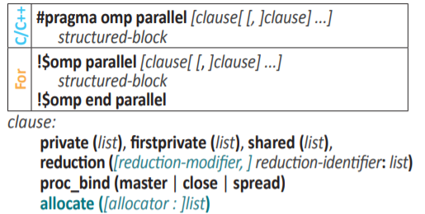
OpenMP parallel regions
Branching in or out of a structured block is not allowed!

Slide 19
OpenMP parallel regions
Serial code – Variable declarations, functions etc.
int a,b,c = 0;
float x = 1.0;
When should I execute this code in parallel?
if clause
#pragma omp parallel num_threads 8 private(a) …..
{
My Parallel Region (piece of code)
Which variables are local to each thread?
private clause
int i = 5;
int j = 10;
int a =threadNumber;
}
Number of threads or copies of the parallel region to execute
num_threads
Which variables are shared across all threads?
shared clause

Slide 20
OPENMP: Variable Scope
In OpenMP, scope refers to the set of threads that can see a variable in a parallel block.
A general rule is that any variable declared outside of a parallel region has a shared scope. In some sense, the “default” variable scope is shared.
When a variable can be seen/read/written by all threads in a team, it is said to have shared scope;
A variable that can be seen by only one thread is said to have private scope. Each thread has a copy of the private variable.
Loop variables in an omp for are private
Local variables in the parallel region are private
Change default behavior by using the clause default(shared) or default(private)

Slide 21
OpenMP: Data Scoping
Challenge in Shared Memory Parallelization => Managing Data Environment
Scoping
OpenMP Shared variable : Can be Read/Written by all Threads in the team.
OpenMP Private variable : Each Thread has its own local copy of this variable
Loop variables in an omp for are private;
Local variables in the parallel region are private.
Alter default behaviour with the {default} clause:
#pragma omp parallel default(shared) private(x)
{ ... }
#pragma omp parallel default(private) shared (matrix)
{ ... }
int i;
int j;
#pragma omp parallel private(j)
{
int k;
i = …….
j = ……..
k = …
}
Shared
Private
Notes:
If a variable is shared, then there exists one instance of this variable which is shared among all threads. If a variable is private, then each thread in a team of threads has its own local copy of the private variable. Shared Variable has the same address in the execution context of every thread.
Global variables (declared outside the scope of a parallel region) are shared among threads unless explicitly made private
• Automatic variables declared within parallel region scope are private
• Stack variables declared in functions called from within a parallel region are private 9
#pragma omp parallel private(x)
• each thread receives its own uninitialized variable x
• the variable x falls out-of-scope after the parallel region
• a global variable with the same name is unaffected (3.0 and later)
#pragma omp parallel firstprivate(x)
• x must be a global-scope variable
• each thread receives a by-value copy of x
• the local x’s fall out-of-scope after the parallel region
• the base global variable with the same name is unaffected

Slide 22
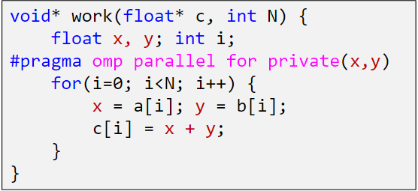
OpenMP: private Clause
Reproduce the private variable for each thread.
Variables are not initialized.
The value that Thread1 stores in x is different from the value Thread2 stores in x

Slide 23
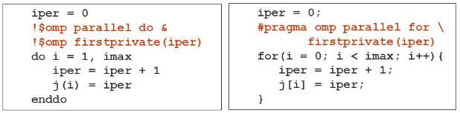
OpenMP: firstprivate Clause
Creates private memory location for iper for each thread.
Copy value from master thread to each memory location
While initial value is same, it can be changed by threads and subsequently Thread 0 Thread 1 and 2.. Might have different values of the firstprivate variable

Slide 24
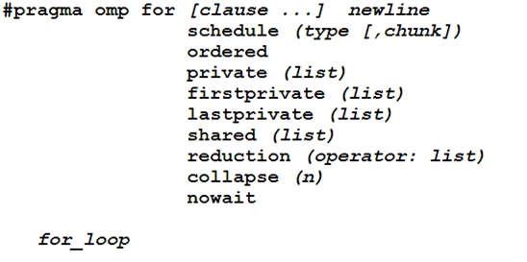
OpenMP: Clauses & Data Scoping
Schedule Clause
Data Sharing/Scope
Notes:
The schedule clause affects how loop iterations are mapped onto threads

Slide 25
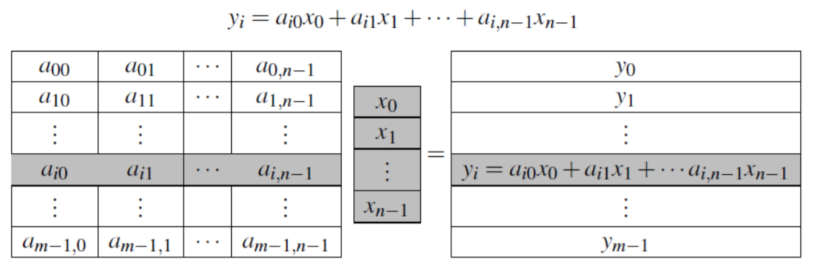
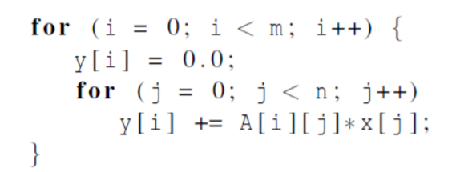
Matrix Vector Multiplication
#pragma omp parallel num_threads(4)
for (i=0; i < m; i++)
{ y[i] =0.0;
for (j=0; j < SIZE; j++)
y[i] += (A[i][j] * x[j]);
}
Is this reasonable?

Slide 26
Matrix Vector Multiplication
#pragma omp parallel shared(A,x,y,SIZE) \ private(tid,i,j,istart,iend)
{
tid = omp_get_thread_num();
int nid = omp_get_num_threads();
istart = tid*SIZE/nid;
iend = (tid+1)*SIZE/nid;
for (i=istart; i < iend; i++)
{
for (j=0; j < SIZE; j++)
y[i] += (A[i][j] * x[j]);
printf(" thread %d did row %d\t y[%d]=%.2f\t",tid,i,i,y[i]);
}
} /* end of parallel construct */
Matrix Rows = N (= 8)
Number of Threads = T (=4)
Number of Rows processed by thread = N/T
Thread 0 => rows 0,1,2,3,…(N/T – 1)
Thread 1 => rows N/T, N/T+1…… 2*N/T - 1
Thread t => rows t, t+1, t+2, …. (t*N/T -1)

Slide 27
Matrix Vector Multiplication
omp_set_num_threads(4)
#pragma omp parallel shared(A,x,y,SIZE)
{
#pragma omp for
for (int i=0; i < SIZE; i++)
{
for (int j=0; j < SIZE; j++)
y[i] += (A[i][j] * x[j]);
}
} /* end of parallel construct */
#pragma omp for must be inside a parallel region (#pragma omp parallel)
No new threads are created but the threads already created in the enclosing parallel region are used.
The system automatically parallelizes the for loop by dividing the iterations of the loop among the threads.
User can control how to divide the loop iterations among threads by using the schedule clause.
User controlled Variable Scope
Matrix Rows = N (= 8)
Number of Threads = T (=4)
Number of Rows processed by thread = N/T
Thread 0 => rows 0,1,2,3,…(N/T – 1)
Thread 1 => rows N/T, N/T+1…… 2*N/T - 1
Thread t => rows t, t+1, t+2, …. (t*N/T -1)

Slide 28
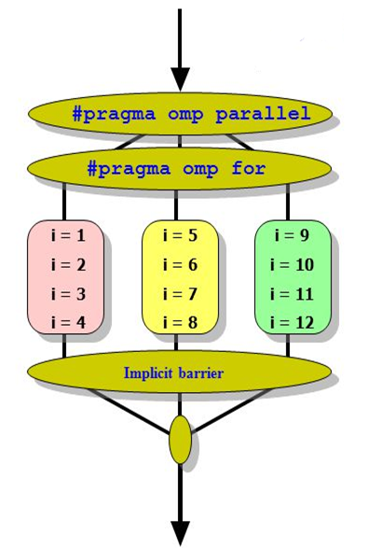
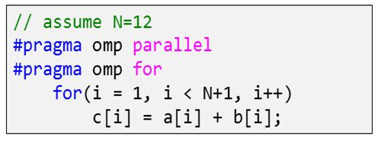
#pragma omp for
#pragma omp parallel for
OpenMP takes care of partitioning the iteration space for you.
Threads are assigned independent sets of iterations.
There is no implied barrier upon entry to a work-sharing construct, There is an implied barrier at the end of a work sharing construct

Slide 29
OpenMP: Work Sharing
Data parallelism
Large amount of data elements and each data element (or possibly a subset of elements) needs to be processed to produce a result. When this processing can be done in parallel, we have data parallelism (for loops)
Task parallelism
A collection of tasks that need to be completed. If these tasks can be performed in parallel you are faced with a task parallel job

Slide 30

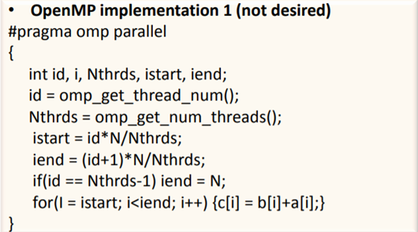
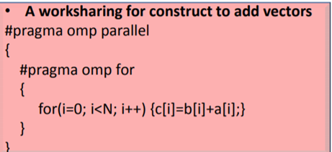
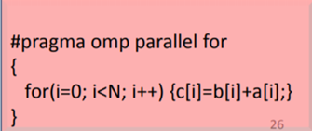
Work Sharing: omp for

Slide 31
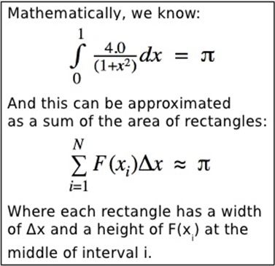
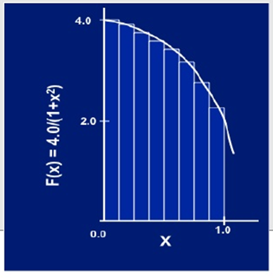
Computing ∏ by method of Numerical Integration
Divide the interval (x axis) [0,1] into N parts.
Area of each rectangle is x * y [ x = 1/N, y = 4/ (1+x²)] =[1/N] *4/ (1+x²)
Approximation of x as midpoint of the interval before computing Y
X_{i} + X_{i+1}
2

Slide 32
Serial Code
static long num_steps = 100000;
double step;
void main ()
{
int i; double x, pi, sum = 0.0;
step = 1.0 / (double) num_steps;
for (I = 0; I <= num_steps; i++)
{
x = (I + 0.5) * step;
sum = sum + 4.0 / (1.0 + x*x);
}
pi = step * sum
}
task1
task2
Computation of the areas of individual rectangles
Adding the areas of rectangles.
There is no communication among the tasks in the first collection, but each task in the first collection communicates with task 2

Slide 33
Computing ∏ by method of Numerical Integration
static long num_steps = 100000;
double step;
void main ()
{
int i; double x, pi, sum = 0.0;
step = 1.0 / (double) num_steps;
for (I = 0; I <= num_steps; i++) {
x = (I + 0.5) * step;
sum = sum + 4.0 / (1.0 + x*x);
}
pi = step * sum
}
#include <omp.h>
#define NUM_THREADS 4
static long num_steps = 100000;
double step;
void main ()
{
int i; double x, pi, sum = 0.0;
step = 1.0 / (double) num_steps;
omp_set_num_threads(NUM_THREADS);
#pragma omp parallel for shared(sum) private(x)
for (I = 0; I <= num_steps; i++) {
x = (I + 0.5) * step;
sum = sum + 4.0 / (1.0 + x*x);
}
pi = step * sum
}
Serial Code
Parallel Code
Notes:
For good openMP implementations, reduction is more scalable than critical

Slide 34

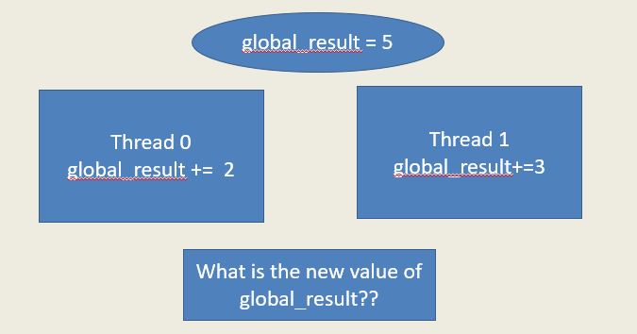
Race Condition
#pragma omp parallel for shared(global_result) private(x, myresult)
for (I = 0; I <= num_steps; i++) {
x = (I + 0.5) * step;
myresult = 4.0 / (1.0 + x*x);
global_result += myresult;
}
Unpredictable results when two (or more) threads attempt to simultaneously execute:
global_result += myresult
Notes:
For good openMP implementations, reduction is more scalable than critical

Slide 35
Handling Race Conditions
Thread 0 Global_result +=2
Mutual Exclusion:
Only one thread at a time executes the statement
Pretty much sequential
Thread1
Global_result +=3
Thread2
Global_result +=4
Notes:
master is very similar to single with two differences:
master will be executed by the master only while single can be executed by whichever thread reaching first the region; and
single has an implicit barrier upon completion of the region, where all threads wait for synchronisation, while master doesn't have any
atomic is very similar to critical, but is restricted for a selection of simple operations

Slide 36
Handling Race Conditions
omp_set_num_threads(NUM_THREADS);
#pragma omp parallel for shared(sum) private(x)
for (I = 0; I <= num_steps; i++) {
x = (I + 0.5) * step;
#pragma omp critical
sum = sum + 4.0 / (1.0 + x*x);
}
Mutual Exclusion:
Only one thread at a time executes the statement
sum = sum + 4.0 / (1.0 + x*x);
Use synchronization to protect data conflicts.
Mutual Exclusion (#pragma omp critical)
Mutual Exclusion (#pragma omp atomic)
Synchronization could be expensive so:
Change how data is accessed to minimize the need for synchronization.
Notes:
master is very similar to single with two differences:
master will be executed by the master only while single can be executed by whichever thread reaching first the region; and
single has an implicit barrier upon completion of the region, where all threads wait for synchronisation, while master doesn't have any
atomic is very similar to critical, but is restricted for a selection of simple operations

Slide 37
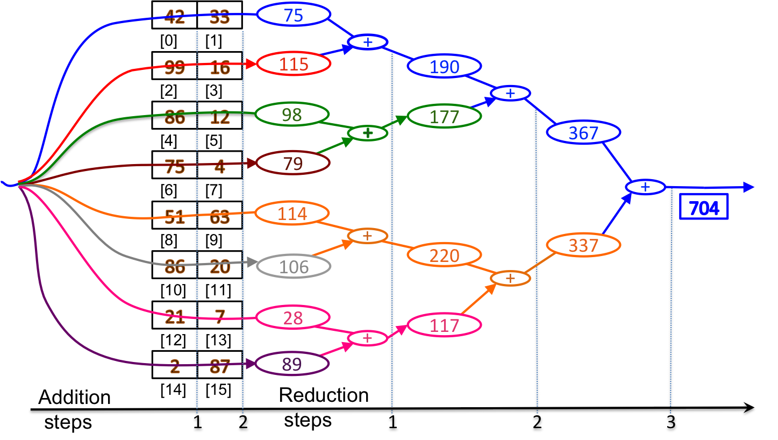
OpenMP: Reduction
sum = 0;
set_omp_num_threads(8)
#pragma omp parallel for
reduction (+:sum)
for (int i = 0; i < 16; i++)
{
sum += a[i]
}
Thread0 => iteration 0 & 1
Thread1 => iteration 2 & 3
………
Thread local/private
One or more variables that are private to each thread are subject of reduction operation at the end of the parallel region.
#pragma omp for reduction(operator : var)
Operator: + , * , - , & , | , && , ||, ^
Combines multiple local copies of the var from threads into a single copy at master.
Notes:
We are combining values into a single accumulation variable (ave) … there is a true dependence between loop iterations that can’t be trivially removed

Slide 38
Computing ∏ by method of Numerical Integration
static long num_steps = 100000;
double step;
void main ()
{
int i; double x, pi, sum = 0.0;
step = 1.0 / (double) num_steps;
for (I = 0; I <= num_steps; i++) {
x = (I + 0.5) * step;
sum = sum + 4.0 / (1.0 + x*x);
}
pi = step * sum
}
#include <omp.h>
#define NUM_THREADS 4
static long num_steps = 100000;
double step;
void main ()
{
int i; double x, pi, sum = 0.0;
step = 1.0 / (double) num_steps;
omp_set_num_threads(NUM_THREADS);
#pragma omp parallel for reduction(+:sum) private(x)
for (I = 0; I <= num_steps; i++) {
x = (I + 0.5) * step;
sum += 4.0 / (1.0 + x*x);
}
pi = step * sum
}
Serial Code
Parallel Code
Notes:
For good openMP implementations, reduction is more scalable than critical

Slide 39
omp for Parallelization
Can all loops be parallelized?
Loop iterations have to be independent.
Simple Test: If the results differ when the code is executed backwards, the loop cannot by parallelized!
for (int i = 2; i < 10; i++)
{
x[i] = a * x[i-1] + b
}
Between 2 Synchronization points, if atleast 1 thread writes to a memory location, that atleast 1 other thread reads from => The result is non-deterministic
Notes:
In the constructs for declaring parallel regions above, you had little control over in what order threads executed the work they were assigned.
synchronization constructs: ways of telling threads to bring a certain order to the sequence in which they do things.

Slide 40
Recap
What is OPENMP?
Fork/Join Programming model
OPENMP Core Elements
#pragma omp parallel OR Parallel construct
run time variables
environment variables
data scoping (private, shared…)
work sharing constructs
#pragma omp for
sections
tasks
schedule clause
synchronization
compile and run openmp program in c++ and fortran

Slide 41
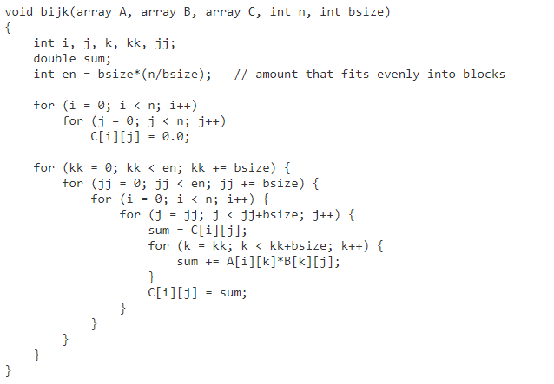

Slide 42
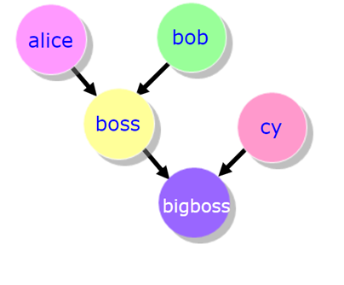
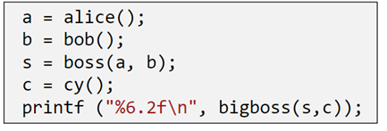
Work Sharing: sections
SECTIONS directive is a non-iterative work-sharing construct.
It specifies that the enclosed section(s) of code are to be divided among the threads in the team.
Each SECTION is executed ONCE by a thread in the team.
Notes:
Exploit Functional Level Parallelism with Work Sharing (SECTIONS)

Slide 43
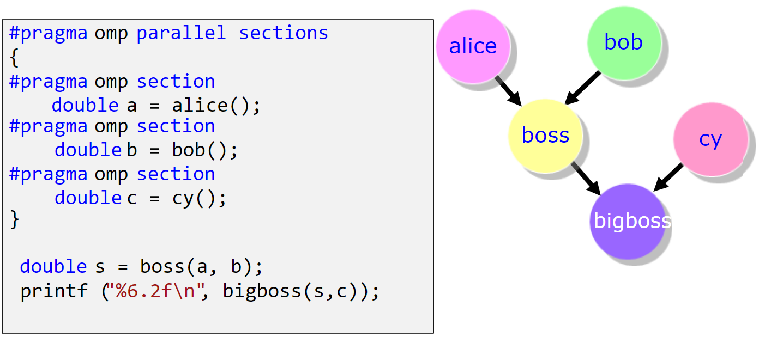
Work Sharing: sections
Notes:
Exploit Functional Level Parallelism with Work Sharing (SECTIONS)

Slide 44
OpenMP: lastprivate Clause
!$OMP DO PRIVATE(I) LASTPRIVATE(B)
DO i = 1, 1000
B = i
ENDDO
!$OMP END DO
!—value of B here is 1000
!$OMP SECTIONS LASTPRIVATE(B)
!$OMP SECTION
B = 2
!$OMP SECTION
B = 4
!$OMP SECTION
D = 6
!$OMP END SECTIONS
Creates private memory location for each thread.
Does not initialize the private variable.
The sequentially last iteration of the associated loops, or the lexically last section construct [...] to the original list item.

Slide 45
Work Sharing: tasks
#pragma omp task [clauses]……
Tasks allow to parallelize irregular problems (Unbounded loops & Recursive algorithms )
A task has - Code to execute – Data environment (It owns its data) – Internal control variables – An assigned thread that executes the code and the data
Each encountering thread packages a new instance of a task (code and data)
Some thread in the team executes the task at some later time
Notes:
Exploit Functional Level Parallelism with Work Sharing (SECTIONS)

Slide 46
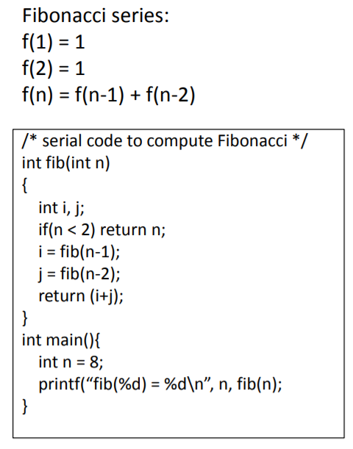
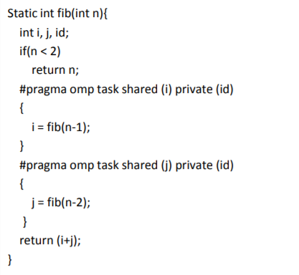
Work Sharing: tasks
#pragma omp taskwait
Notes:
Exploit Functional Level Parallelism with Work Sharing (SECTIONS)

Slide 47
Work Sharing: single
The SINGLE directive specifies that the enclosed code is to be executed by only one thread in the team.
May be useful when dealing with sections of code that are not thread safe (such as I/O)
!$OMP SINGLE [clause ...]
PRIVATE (list)
FIRSTPRIVATE (list)
block
!$OMP END SINGLE [ NOWAIT ]
#pragma omp single [clause ...] newline private (list) firstprivate (list) nowait structured_block
Notes:
Exploit Functional Level Parallelism with Work Sharing (SECTIONS)

Slide 48
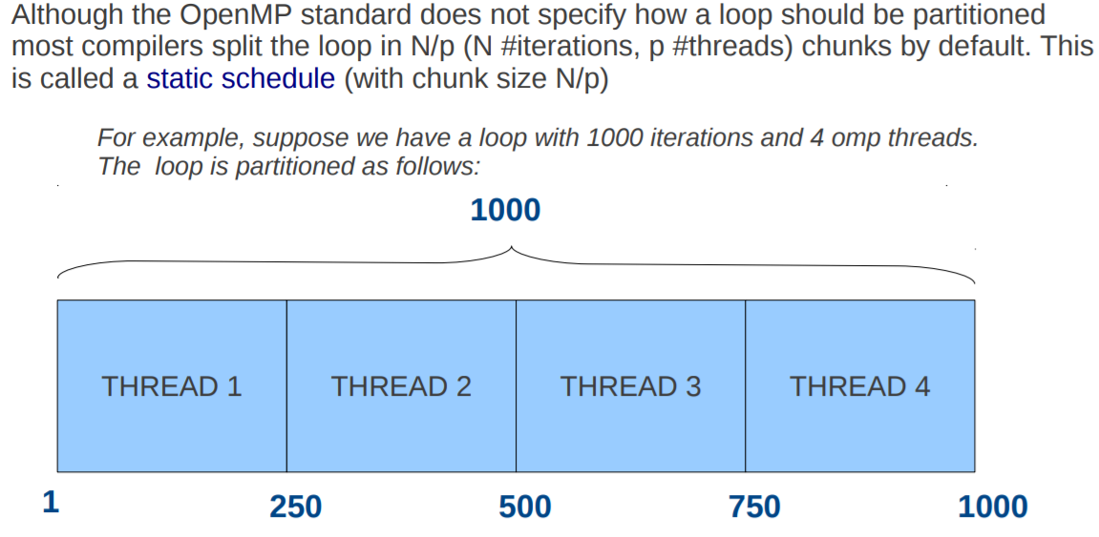
Schedule Clause
How is the work is divided among threads?
Directives for work distribution
Notes:
Static: Pre-determined and predictable by the programmer
Dynamic: Unpredictable, highly variable work per iteration
Guided: Special case of dynamic to reduce scheduling overhead
Way in which parallel loop iterations are distributed among the threads
Depends upon whether each loop iteration yields the same amount of work
Schedule clause schedule(type[, chunk_size])
Static schedule - each thread is assigned a fixed number of chunks (default)
Chunks are groups of iterations (in contiguous order) that are assigned to threads
Dynamic schedule - each thread grabs "chunk" iterations until all iterations are done
Faster threads are assigned more iterations
Interleaved is when chunks are assigned to the processors in a round-robin manner
Guided is a variant of dynamic scheduling where successive chunks get smaller
Runtime is determined at runtime and set by a environment variable

Slide 49
Schedule Clause: Types
A schedule kind is passed to an OpenMP loop schedule clause:
provides a hint for how iterations of the corresponding OpenMP loop should be assigned to threads in the team of the OpenMP region surrounding the loop.
Five kinds of schedules for OpenMP loop1:
static
dynamic
guided
auto
runtime
The OpenMP implementation and/or runtime defines how to assign chunks to threads of a team given the kind of schedule specified by as a hint.
Notes:
Static: Pre-determined and predictable by the programmer
Dynamic: Unpredictable, highly variable work per iteration
Guided: Special case of dynamic to reduce scheduling overhead
Way in which parallel loop iterations are distributed among the threads
Depends upon whether each loop iteration yields the same amount of work
Schedule clause schedule(type[, chunk_size])
Static schedule - each thread is assigned a fixed number of chunks (default)
Chunks are groups of iterations (in contiguous order) that are assigned to threads
Dynamic schedule - each thread grabs "chunk" iterations until all iterations are done
Faster threads are assigned more iterations
Interleaved is when chunks are assigned to the processors in a round-robin manner
Guided is a variant of dynamic scheduling where successive chunks get smaller
Runtime is determined at runtime and set by a environment variable

Slide 50
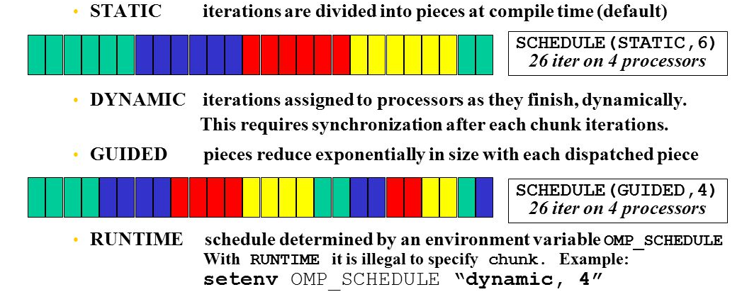
Schedule Clause
Notes:
Static: Pre-determined and predictable by the programmer
Dynamic: Unpredictable, highly variable work per iteration
Guided: Special case of dynamic to reduce scheduling overhead
Way in which parallel loop iterations are distributed among the threads
Depends upon whether each loop iteration yields the same amount of work
Schedule clause schedule(type[, chunk_size])
Static schedule - each thread is assigned a fixed number of chunks (default)
Chunks are groups of iterations (in contiguous order) that are assigned to threads
Dynamic schedule - each thread grabs "chunk" iterations until all iterations are done
Faster threads are assigned more iterations
Interleaved is when chunks are assigned to the processors in a round-robin manner
Guided is a variant of dynamic scheduling where successive chunks get smaller
Runtime is determined at runtime and set by a environment variable

Slide 51
Schedule Clause
STATIC: Iterations of a loop are divided into chunks of size ceiling(iterations/threads). Each thread is assigned a separate chunk.
STATIC, N: Iterations of a loop are divided into chunks of size N. Each chunk is assigned to a thread in round-robin fashion. N >= 1 (integer expression)
DYNAMIC: Iterations of a loop are divided into chunks of size 1.
Chunks are assigned to threads on a first-come, first-serve basis as threads become available. This continues until all work is completed.
DYNAMIC, N: Same as above, all chunks are set to size N
GUIDED: Chunks are made progressively smaller until a chunk size of one is reached. The first chunk is of size ceiling(iterations/threads). Remaining chunks are of size ceiling(iterations_remaining/threads).Chunks are assigned to threads on a first-come, first-serve basis as threads become available. This continues until all work is completed.
GUIDED, N: Minimum chunk size is N
AUTO: Delegated the decision of the scheduling to the compiler and/or runtime system
RUNTIME: Scheduling policy is determined at run time. OMP_SCHEDULE/ OMP_SET_SCHEDULE

Slide 52
OpenMP: Synchronization
The programmer needs finer control over how variables are shared.
The programmer must ensure that threads do not interfere with each other so that the output does not depend on how the individual threads are scheduled.
In particular, the programmer must manage threads so that they read the correct values of a variable and that multiple threads do not try to write to a variable at the same time.
MASTER, CRITICAL, BARRIER, FLUSH, TASKWAIT, ORDERED, NOWAIT
Notes:
Thread 0 is on CPU0 and at the fork 3 new threads are created and distributed to the remaining 3 CPUs

Slide 53
Synchronization Constructs
To impose order constraints and protect shared data.
Achieved by Barriers & Mutual Exclusion
1) Barriers (Task Dependencies)
Implicit : Sync points exist at the end of
parallel –necessary barrier – cant be removed
for – can be removed by using the nowait clause
sections – can be removed by using the nowait clause
single – can be removed by using the nowait clause
Explicit : Must be used when ordering is required
#pragma omp barrier
each thread waits until all threads arrive at the barrier
Notes:
In the constructs for declaring parallel regions above, you had little control over in what order threads executed the work they were assigned.
synchronization constructs: ways of telling threads to bring a certain order to the sequence in which they do things.
Barrier: Each thread waits until all threads arrive
The single construct denotes a block of code that is executed by only one thread (not necessarily the master thread)

Slide 54
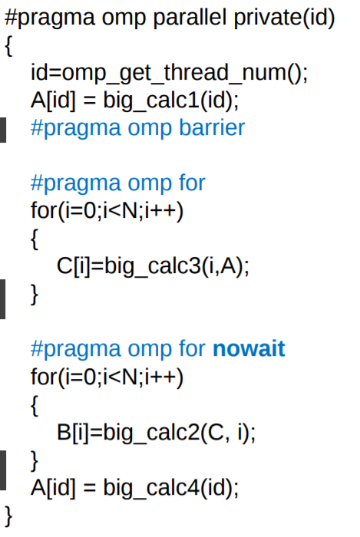
Synchronization: Barrier
Explicit Barrier
Implicit Barrier at end of parallel region
No Barrier nowait cancels barrier creation

Slide 55
Data Dependencies
OpenMP assumes that there is NO data-dependency across jobs running in parallel
When the omp parallel directive is placed around a code block, it is the programmer’s responsibility to make sure data dependency is ruled out

Slide 56
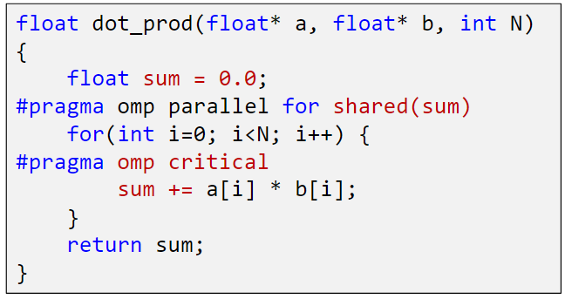
Synchronization Constructs
2) Mutual Exclusion (Data Dependencies)
Critical Sections : Protect access to shared & modifiable data, allowing ONLY ONE thread to enter it at a given time
#pragma omp critical
#pragma omp atomic – special case of critical, less overhead
Locks
Only one thread updates this at a time
Notes:
Synchronization is achieved by mutual exclusion

Slide 57
OPENMP Synchronization: review
PRAGMA | DESCRIPTION
#pragma omp taskwait !$OMP TASKWAIT | Specifies a wait on the completion of child tasks generated since the beginning of the current task
#pragma omp critical !$OMP CRITICAL !$OMP END CRITICAL | Code within the block or pragma is only executed on one thread at a time.
#pragma omp critical !$OMP ATOMIC !$OMP END ATOMIC | Provides a mini-CRITICAL section. specific memory location must be updated atomically (Atomic statements)
#pragma omp barrier !$OMP BARRIER !$OMP END BARRIER | Synchronizes all threads in a team; all threads pause at the barrier, until all threads execute the barrier.
Notes:
master is very similar to single with two differences:
master will be executed by the master only while single can be executed by whichever thread reaching first the region; and
single has an implicit barrier upon completion of the region, where all threads wait for synchronisation, while master doesn't have any
atomic is very similar to critical, but is restricted for a selection of simple operations

Slide 58
OPENMP Synchronization: review
PRAGMA | DESCRIPTION
#pragma omp for ordered [clauses...] (loop region) #pragma omp ordered structured_block | Used within a DO / for loop Iterations of the enclosed loop will be executed in the same order as if they were executed on a serial processor. Threads will need to wait before executing their chunk of iterations if previous iterations haven't completed yet.
#pragma omp flush (list) | Synchronization point at which all threads have the same view of memory for all shared objects. FLUSH is implied for barrier parallel - upon entry and exit critical - upon entry and exit ordered - upon entry and exit for - upon exit sections - upon exit single - upon exi
Notes:
master is very similar to single with two differences:
master will be executed by the master only while single can be executed by whichever thread reaching first the region; and
single has an implicit barrier upon completion of the region, where all threads wait for synchronisation, while master doesn't have any
atomic is very similar to critical, but is restricted for a selection of simple operations

Slide 59
Installing and running C/C++/Fortran Programs on multicore machines
The GNU Project https://gcc.gnu.org/install/binaries.html
MacOS:
The Homebrew package manager : https://brew.sh/
MacPorts https://www.macports.org/
MS Windows
The Cygwin project https://sourceware.org/cygwin/
MinGW and mingw-w64 projects http://www.mingw.org/ http://mingw-w64.org/doku.php
Linux machines come pre installed with gnu binaries
gcc --version
gfortran --version

Slide 60
Environment Variables
LINUX /UNIX bash /Cygwin:
List all environment variables: printenv
Update environment variable : export OMP_NUM_THREADS=5
LINUX/UNIX csh
List all environment variables: printenv
Update environment variable : setenv OMP_NUM_THREADS 5
Windows/DOS
List all environment variables: set
Update environment variable : set (/A) OMP_NUM_THREADS= 5
OSX
List all environment variables: env
Update environment variable : export OMP_NUM_THREADS= 5

Slide 61
Compiling and running OPENMP Code
Locally
$g++ -fopenmp Program.cpp –o <output_name>
$gfortran –fopenmp Program.f95 –o <output_name>
$./<output_name>

Slide 62
Compiling and running OPENMP Code
On basic clusters at SERC (tyrone, delta)
$ssh <username>@delta-cluster.serc.iisc.ernet.in
$password:
Copy the code onto the home area
Create make files for compiling code (clearing binaries, compiling, linking and creating executable)
Run make
Create a job script to submit the job in batch mode
qsub jobscript
qstat
Check output

Slide 63
OpenMP environment variables
OMP_DYNAMIC : When set to TRUE, the number of threads available for executing parallel regions can be adjusted at run time to make the best use of system resources.
OMP_NESTED: When set to TRUE, nested parallelism is enabled. This means that the runtime environment might deploy extra threads to form the team of threads for the nested parallel region.
OMP_PROC_BIND : When TRUE, binds threads to processors.
OMP_MAX_ACTIVE_LEVELS: The maximum number of active nested parallel regions.
OMP_STACK_SIZE: Specifies the size of the stack for threads that are created by the OpenMP run time. (default in KB). If the compiler cannot deliver the stack size specified by the environment variable, or if OMP_STACKSIZE does not conform to the valid format, the compiler sets the environment variable to the default value.
OMP_WAIT_POLICY: Use ACTIVE if you want waiting threads to mostly be active. That is, the threads consume processor cycles while waiting. For example, waiting threads can spin while waiting. The ACTIVE wait policy is recommended for maximum performance on the dedicated machine. Use PASSIVE if you want waiting threads to mostly be passive. That is, the threads do not consume processor cycles while waiting. For example, waiting threads can sleep or yield the processor to other threads.

Slide 64
OpenMP environment variables
Display OPENMP environment upon execution of the program
$export OMP_DISPLAY_ENV=TRUE (bash)
$setenv OMP_DISPLAY_ENV TRUE (csh)
OPENMP DISPLAY ENVIRONMENT BEGIN
_OPENMP = '201307'
OMP_DYNAMIC = 'FALSE'
OMP_NESTED = 'FALSE'
OMP_NUM_THREADS = '32'
OMP_SCHEDULE = 'DYNAMIC'
OMP_PROC_BIND = 'FALSE'
OMP_PLACES = ''
OMP_STACKSIZE = '140729178218216'
OMP_WAIT_POLICY = 'PASSIVE'
OMP_THREAD_LIMIT = '4294967295'
OMP_MAX_ACTIVE_LEVELS = '2147483647'
OMP_CANCELLATION = 'FALSE'
OMP_DEFAULT_DEVICE = '0'
OPENMP DISPLAY ENVIRONMENT END

Slide 65
Running OpenMP code
Controlling the number of threads at runtime
The default number of threads = number of online processors on the machine.
C shell : setenv OMP_NUM_THREADS number
Bash shell: export OMP_NUM_THREADS = number
Runtime OpenMP function omp_set_num_threads(4)
Clause in #pragma for parallel region
Execution Timing
#include omp.h
stime = omp_get_wtime();
longfunction();
etime = omp_get_wtime();
total = etime-stime;

Slide 66
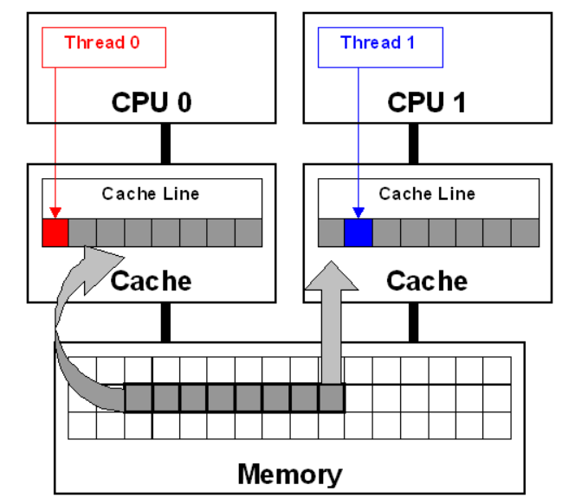
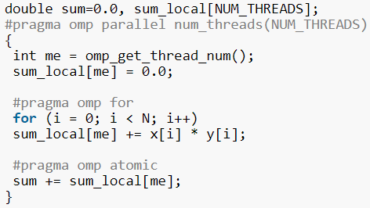
False Sharing
Same cache line
When threads on different processors modify variables that reside on the same cache line. This invalidates the cache line and forces a memory update to maintain cache coherency.
Potential false sharing on the array sum_local

Slide 67
False Sharing - workaround
False sharing degrades performance when all of the following conditions occur.
Shared data is modified by multiple processors.
Multiple processors update data within the same cache line.
This updating occurs very frequently (for example, in a tight loop).
Shared data that is read-only in a loop does not lead to false sharing.
Compilers are aware of false sharing, they do a good job of eliminating instances where it could occur. When the code is compiled with optimization options, the compiler eliminates false sharing using thread-private temporal variables.
Code Inspection: Instances where threads access global or dynamically allocated shared data structures are potential sources of false sharing
Making use of private data as much as possible
Changing the mapping of iterations to threads, giving each thread more work per chunk (by changing the chunksize value)

Slide 68
OpenMP Best Practices
Memory Access Patterns (optimize cache usage)
Two dimensional array access (row or column)
Loop unrolling, fusion
Measure OpenMP performance
Understand Parallel Overhead
Thread start-up time
Synchronization
Software overhead imposed by parallel compilers, libraries, tools, operating system, etc.
Thread termination time
Load imbalance overheads

Slide 69
secguest (1- 5)
tyrone-cluster.serc.iisc.ernet.in
cat todo.txt
secguest (6- 10)
delta-cluster.serc.iisc.ernet.in
cat todo.txt

